Slide 1
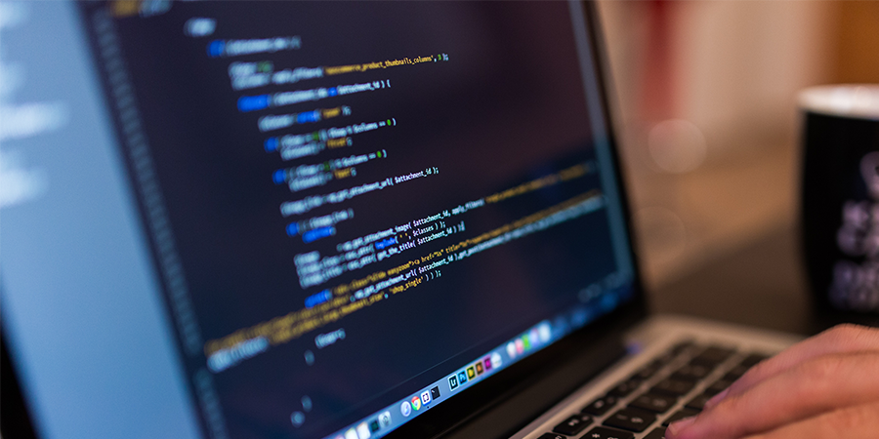
Programming with JavaScript and jQuery
Day 2

Slide 2
Chapter 3
Building Arrays and Controlling Flow

Slide 3
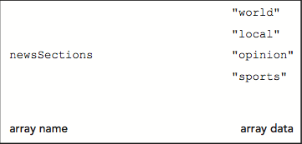
Arrays
Array
Set of data represented by a single variable name.
You can think of an array as a collection of variables contained within a single variable.
Figure 3-1 Conceptual illustration of an array

Slide 4
Declaring and Initializing Arrays
Array literal
A single statement that declares a variable and specifies array values as its conent.
The most common way to create an array.
Syntax
var name = [value1, value2, value3, …];
Example:
Create an array named newsSections containing 4 strings as elements
var newsSections = ["world“,"local“,"opinion“,"sports"]

Slide 5
Declaring and Initializing Arrays
Element
Each piece of data contained in an array
Index
Element’s numeric position within the array
Array element numbering
Starts with index number of zero (0)
Reference element using its index number
Example: to reference the 2nd element in the newsSections array
^{newsSections[1]}

Slide 6
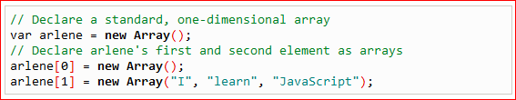
Declaring and Initializing Arrays
Assigning values to individual array elements
Include the array index for an individual element
Example:
Add value "entertainment" as fifth element of newsSections array
Multidimensional array example:
newsSections[4] = "entertainment";
http://freewebdesigntutorials.com/javaScriptTutorials/jsArrayObject/multiDimensionalArrays.htm

Slide 7
Declaring and Initializing Arrays
Can create an array without any elements
Add new elements as necessary
Array size can change dynamically
^{var colors = [];}
^{colors[2] = "yellow";}
JavaScript values assigned to array elements can be different data types.
var hotelReservation = [ ];
//guest name (string)
hotelReservation[0] = “Victor Vuong”
//# of nights (intiger)
hotelReservation[1] = 5;
//price per night (floating point)
hotelReservation[2] = 74.99;

Slide 8
Exercise: Tipton Turbines
Go into the “WA120_data_files” folder.
Double-click on the “Chapter03” folder.
Open the “chapter” sub-folder.
COPY all of the folders and files.
Navigate to where you store your projects and create a new folder named “tipton_turbines”.
Open this new folder and PASTE all of the data files within.

Slide 9
Exercise: Tipton Turbines
In Notepad++, open the file “calendar.htm”
In the comment section add your name and the current date where indicated.
Open the file in your web browser.
Copy the comment section and open up a new document in Notepad.
Paste the comment and change the filename to “tt.js”.
Save the document as “tt.js” as well.

Slide 10
Exercise: Tipton Turbines
On pages 154-155, enter the comments / code listed in steps 6-10 in Notepad++.
When finished, save the “tt.js” file and refresh your browser.
Note: Although the page itself will not change, you can check the console and see that the array values can be called on by typing the variable name and the element index in brackets.
EX: daysOfWeek[3] will return “Wednesday”

Slide 11
Accessing Element Information
To access an element’s value:
Include brackets and element index
Examples:
var newsSections = ["world","local","opinion","sports"]
var sec1Head = document.getElementById("section1");
var sec2Head = document.getElementById("section2");
var sec3Head = document.getElementById("section3");
sec1Head.innerHTML = newsSections[0]; // "world"
sec2Head.innerHTML = newsSections[1]; // "local"
sec3Head.innerHTML = newsSections[2]; // "opinion"

Slide 12
Modifying Elements
To modify values in existing array elements:
Include brackets and element index
Can easily change a value assigned to an array element
Example:
^{newsSections[4] = "living";}

Slide 13
Determining the Number of Elements in an Array
length property
Returns the number of elements in an array
Syntax
name.length;
Ex: daysOfWeek.length

Slide 14
Using the Array Object
JavaScript represents arrays with the Array object
Contains a special constructor named Array()
Constructor
Special function type used as the basis for creating reference variables
Syntax
var newsSections = new Array(6);
Array literals preferred
Easier than using constructor.

Slide 15
Referencing Default Collections of Elements
getElementsByTagName() method
Can reference web page element by looking up all elements of a certain type in document and referencing one element in that collection
Resulting collection uses syntax similar to arrays
Example:
document.getElementsByTagName("li")[2]

Slide 16
Short Quiz 1
How is an array different from a standard variable?
How do you create a new empty array?
How do you access an individual element in an array?
What property do you use to determine the number of elements in an array?
How do you use a browser to check the value of a specific array element?

Slide 17
Repeating Code
D.R.Y – “Don’t Repeat Yourself!”
Loop statement
Control flow statement repeatedly executing a statement or a series of statements
While a specific condition is true or until a specific condition becomes true
Three types of loop statements
while statements
do/while statements
for statements

Slide 18
while Statements
while statement
Repeats a statement or series of statements
As long as a given conditional expression evaluates to a truthy value
Syntax
while (expression) {
statements
}
Iteration
Each repetition of a looping statement

Slide 19
while Statements
Counter
Variable incremented or decremented with each loop statement iteration
Examples:
while statement using an increment operator ++
while statement using a decrement operator --
while statement using the *= assignment operator

Slide 20
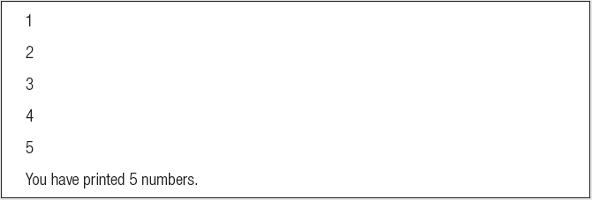
while Statements
var count = 1;
while (count <= 5) {
document.write(count + "<br />");
count++;
}
document.write("<p>You have printed 5 numbers.</p>");
Result in browser:

Slide 21
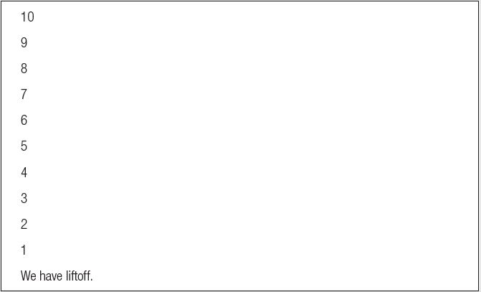
while Statements
var count = 10;
while (count > 0) {
document.write(count + "<br />");
count--;
}
document.write("<p>We have liftoff.</p>");
Result in browser:

Slide 22
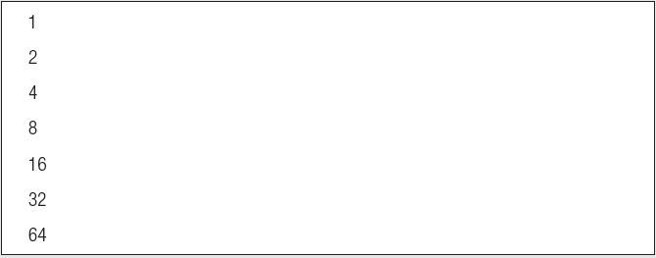
while Statements
var count = 1;
while (count <= 100) {
document.write(count + "<br />");
count *= 2;
}
Result in browser:

Slide 23
while Statements
Infinite loop
Loop statement that never ends
Conditional expression: never false
Example:
What problem may arise from executing an infinite loop?
var count = 1;
while (count <= 10) {
window.alert("The number is " + count + ".");
}

Slide 24
while Statements
Example:
assigning array element values to table cells:
function addColumnHeaders() {
var i = 0;
while (i < 7) {
document.getElementsByTagName("th")[i].innerHTML = daysOfWeek[i];
i++;
}
}

Slide 25
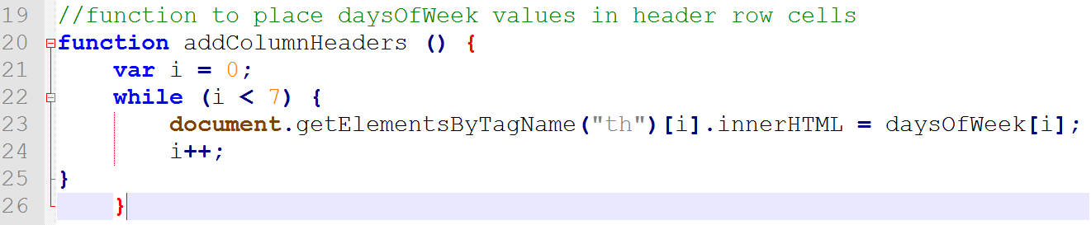
Exercise: Tipton Turbines
Return to the “tt.js” document in Notepad++
Below the variable declarations, enter the following code:

Slide 26
Exercise: Tipton Turbines
Add the following statement below the function you just created:

Slide 27
do/while Statements
do/while statement
Executes a statement or statements once
Then repeats the execution as long as a given conditional expression evaluates to a truthy value
Syntax
do {
statements;
} while (expression);

Slide 28
do/while Statements
Examples:
var count = 2;
do {
document.write("<p>The count is equal to " + count + ".</p>");
count++;
} while (count < 2);
var count = 2;
while (count < 2) {
document.write("<p>The count is equal to " + count + ".</p>");
count++;
}

Slide 29
do/while Statements
Example:
adding days of week with a do/while statement instead of a while statement
var i = 0;
do {
document.getElementsByTagName("th")[i].innerHTML = daysOfWeek[i];
i++;
} while (i < 7);

Slide 30
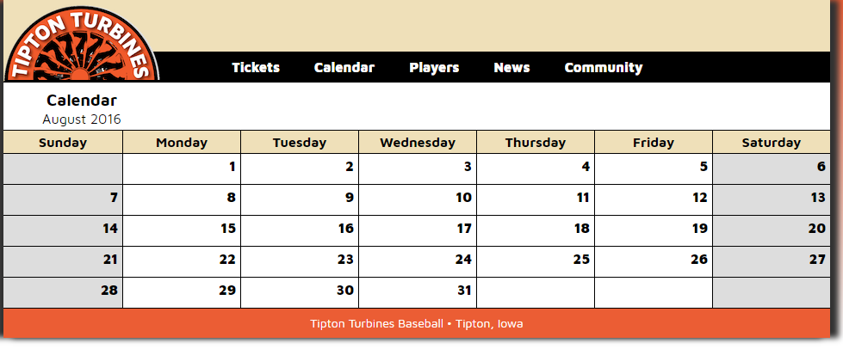
Exercise: Tipton Turbines
Return to “tt.js” in Notepad++
Below the addColumnHeaders() function, add the code detailed on pages 170-172.
Save the “tt.js” file and refresh the browser.

Slide 31
for Statements
for statement
Repeats a statement or series of statements
As long as a given conditional expression evaluates to a truthy value
Can also include code that initializes a counter and changes its value with each iteration
Syntax
for (counter_declaration; condition; counter_operation) {
statements
}

Slide 32
for Statements
Steps when JavaScript interpreter encounters a for loop
1. Counter variable declared and initialized
2. for loop condition evaluated
3. If condition evaluation in Step 2 returns TRUE:
for loop statements execute, Step 4 occurs, and the process starts over again with Step 2
If condition evaluation in Step 2 returns FALSE:
for statement ends
Next statement following the for statement executes
4. Update statement in the for statement executed

Slide 33
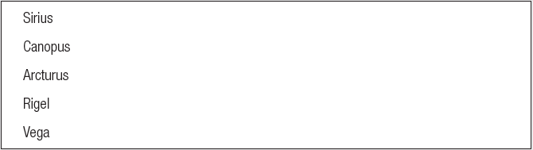
for Statements
var brightestStars = ["Sirius", "Canopus", "Arcturus", "Rigel", "Vega"];
for (var count = 0; count < brightestStars.length; count++) {
document.write(brightestStars[count] + "<br />");
}
Result in browser:

Slide 34
for Statements
Example:
addColumnHeaders() function with a for statement instead of a do/while statement
function addColumnHeaders() {
for (var i = 0; i < 7; i++) {
document.getElementsByTagName("th")[i].innerHTML = daysOfWeek[i];
}
}

Slide 35
Exercise: Tipton Turbines
Return to “tt.js” in Notepad++
Enter the code on Pages 175-177 to add a function below the addCalendarDates( ) function that will populate the calendar dates with the opposing team names using a “for statement”:

Slide 36
Using continue Statements to Restart Loop Execution
continue statement
Halts a looping statement
Restarts the loop with a new iteration
Used to stop a loop for the current iteration
Have the loop to continue with a new iteration
Examples:
for loop with a continue statement

Slide 37
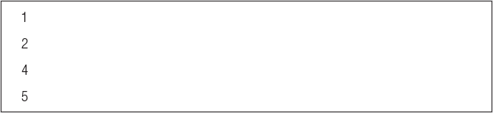
Using continue Statements to Restart Loop Execution
for (var count = 1; count <= 5; count++) {
if (count == 3) {
continue;
}
document.write("<p>" + count + "</p>");
}
Result in browser:

Slide 38
Short Quiz 2
What is the role of a counter in a repetition statement?
What are the differences between a while and a do/while statement?
Which repetition statement allows you to initialize a counter variable as part of its syntax?
How do you force a new iteration of a loop even when its condition evaluates to a falsy value?

Slide 39
Making Decisions
Decision making
Process of determining the order in which statements execute in a program
Decision-making statements, decision-making structures, or conditional statements
Special types of JavaScript statements used for making decisions
if statement
Most common type of decision-making statement

Slide 40
if Statements
Used to execute specific programming code IF conditional expression evaluation returns TRUE
Syntax
if (condition) {
statements
}
After the if statement executes:
Any subsequent code executes normally

Slide 41
Exercise: Tipton Turbines
Return to “tt.js” in Notepad++
Within the addGameInfo ( ) function, in the data block for the for loop, insert a new line before the final statement and enter the code shown on Pages 181-184.

Slide 42
if/else Statements
Executes one action if the condition is TRUE and a different action if the condition is FALSE
Syntax for an if . . . else statement
if (expression) {
statements
} else {
statements
}

Slide 43
if/else Statements
Example:
var today = "Tuesday"
if (today === "Monday") {
document.write("<p>Today is Monday</p>");
}
else {
document.write("<p>Today is not Monday</p>");
}

Slide 44
Exercise: Tipton Turbines
Return to “tt.js” in Notepad++
On Pages 186-188, follow the steps to enter the code which will add an if/else statement to the addGameInfo ( ) function.

Slide 45
Nested if and if/else Statements
Nested decision-making structures
One decision-making statement contains another decision-making statement
Nested if statement
An if statement contained within an if statement or within an if/else statement
Nested if/else statement
An if/else statement contained within an if statement or within an if/else statement
Example:
var salesTotal = 75;
if (salesTotal > 50) {
if (salesTotal < 100) {
document.write("<p>The sales total is
between 50 and 100.</p>");
}
}

Slide 46
else if constructions
Compact version of nested if/else statements
combine an else statement with its nested if statement
requires fewer characters
easier to read
if (gameLocation[i] === "away") {
paragraphs[1].innerHTML = "@ ";
}
else {
if (gameLocation[i] === "home") {
paragraphs[1].innerHTML = "vs ";
}
}
if (gameLocation[i] === "away") {
paragraphs[1].innerHTML = "@ ";
}
else if (gameLocation[i] === "home") {
paragraphs[1].innerHTML = "vs ";
}

Slide 47
switch Statements
Controls program flow by executing a specific set of statements
Dependent on an expression value
Compares expression value to value contained within a case label
case label
Represents a specific value
Contains one or more statements that execute:
If case label value matches the switch statement’s expression value
switch (expression) {
case label:
statements;
break;193
case label:
statements;
break;
...
default:
statements;
break;
}

Slide 48
switch Statements
function city_location(americanCity) {
switch (americanCity) {
case "Boston":
return "Massachusetts";
break;
case "Chicago":
return "Illinois";
break;
case "Los Angeles":
return "California";
break;
case "Miami":
return "Florida";
break;
case "New York":
return "New York";
break;
default:
return "United States";
break;
}
}
document.write("<p>" + city_location("Boston") + "</p>");
default label
Executes when the value returned by the switch statement expression does not match a case label
When a switch statement executes:
Value returned by the expression is compared to each case label
In the order in which it is encountered
break statement
Ends execution of a switch statement
Should be final statement after each case label

Slide 49
Short Quiz 3
What does an if statement do when its condition evaluates to a falsy value?
What can you do with an if/else statement that you can’t do with an if statement?
Why would you nest decision-making statements?
How do you specify possible values for the expression in a switch statement?
What statement should you include at the end of the code for each case label in a switch statement? Why is it important?

Slide 50
Exercise
Add a conditional statement to the “Lunch Selections” exercise. If the user selects more than three options, display an alert message that says “You can select up to three options”.

